Slide 1
CGT620 Lab4
Jichun Zheng

Slide 2
Input Output (Gaussian decay)

Slide 3
Cartridge Buffer
Unsigned Char *ctrdgBuff [ n ];
For each image processed{
Load new image;
free( ctrdgBuff [ 0 ] );
ctrdgBuff [0] = ctrdgBuff [1];
ctrdgBuff [1] = ctrdgBuff [2];
ctrdgBuff [2] = ctrdgBuff [3];
… ;
ctrdgBuff[ n-1 ] = new image;
Copy **ctrdgBuff to GPU;
Launch kernel ( ctrdgBuff );
Write to PNG;
}

Slide 4
Circular Buffer
Unsigned Char* d_imgIn;
Buffer Size = n * imgSize
CudaMalloc( &d_imgIn, n * imgSize)
For ith image processed{
Read new image;
cudaMemcpy( d_imgIn + (ith % n) * imgSize, new image );
Kernel (d_imgIn, ith);
Write to PNG
}
CudaFree( d_imgIn );

Slide 5
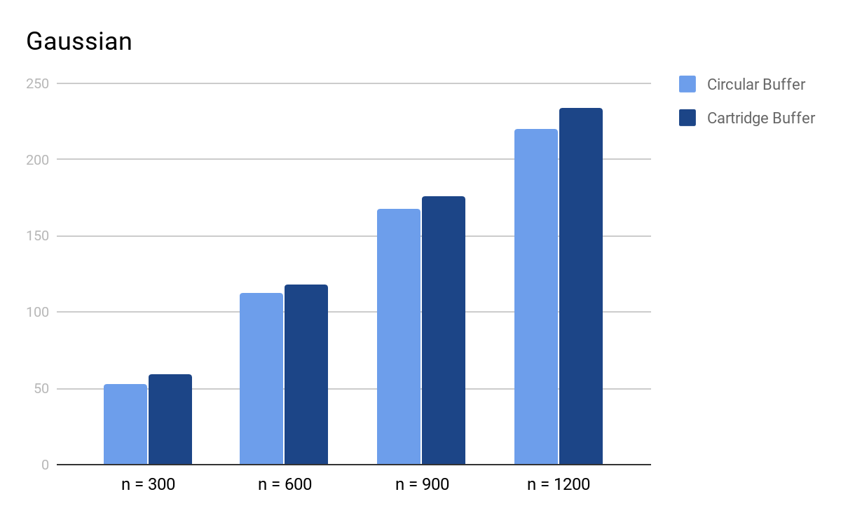
Time taken with increase of n (Gaussian)

Slide 6
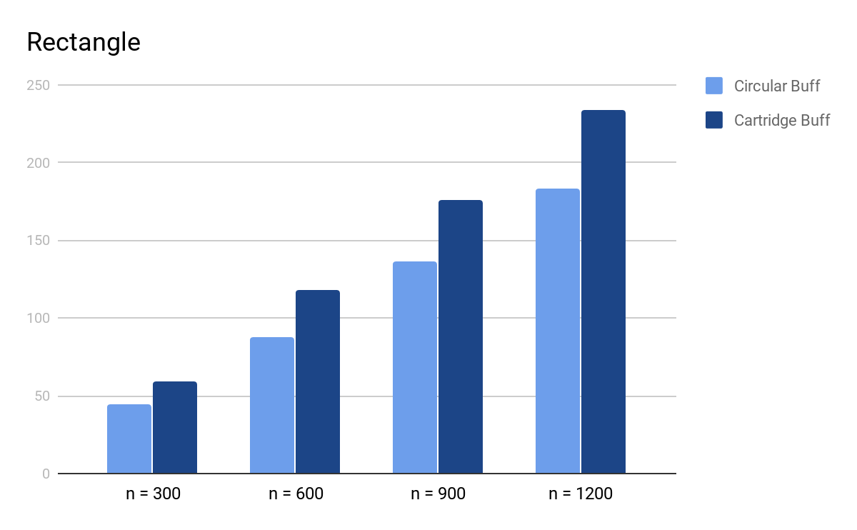
Time taken with increase of n (Rectangle)

Slide 7


For each image processed (Gaussian)
Circular
Cartridge

Slide 8

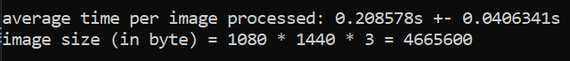
For each image processed (Rectangle)
Circular
Cartridge

Slide 9


For each image processed (Triangle)
Circular
Cartridge

